Slide 1
Inferential Statistics
&
Applied Probability
Course Code: DS221
Credits: 3
Instructor: Muhammad Sajid Ali

Slide 2
Median
To organize the data, we first sort it
Then if the number of items N is odd
  median = middle item's value
If the number of items N is even
  median = mean of middle 2 items' values

Slide 3
Median
Example
Consider the following dataset
  Dataset = {3, 7, 1, 5, 9}
  Sorted dataset = {1, 3, 5, 7, 9}
  Middle value is 5 so is the media
This means 50% of the data is less and greater than 5

Slide 4
Properties of the Median
Scaling data scales the median
Translating the data does translates the median

Slide 5
Percentile
k^{th} percentile is the value relative to which k% of the data items have smaller or equal numbers
Median is roughly the 50th percentile

Slide 6
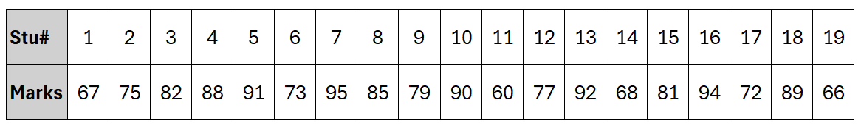
Percentile
Consider the following dataset of twenty (20) students and their final marks out of 100

Slide 7
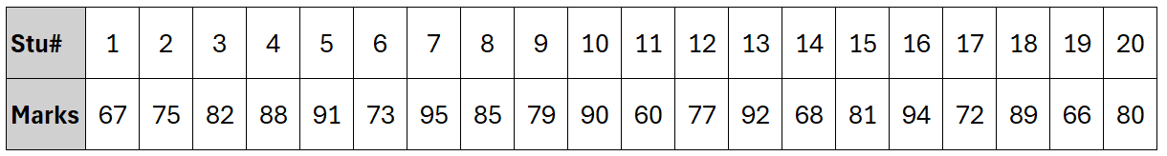
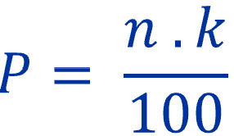
Percentile
Consider the following dataset of twenty (20) students and their final marks out of 100
We will use the following formula to calculate the K^{th} percentile (aka rank method)
  Where 𝑃 is the rank, 𝑛 is the number of data points (students), and 𝑘 is the percentile

Slide 8
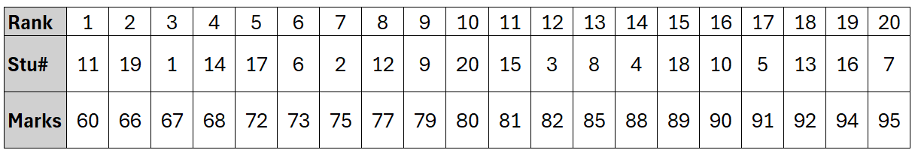
Percentile
Calculate the rank
Let’s find the 75th and 25th percentile
  P = 20 x 75 / 100 → 15th value in dataset
Locate the percentile
  The 15th student in the rank list has a score of 89
  This means that 75% of the students scored 89 or lower.

Slide 9
Percentile
Can you find the 25th percentile?

Slide 10
Percentile
Can you find the 25th percentile?
25th percentile
  P = 20 x 25 / 100 → 5th value in dataset
Locate the percentile
  The 5th student in the rank list has a score of 72
  This means that 25% of the students scored 72 or lower.

Slide 11
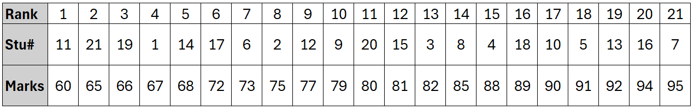
Percentile
Can you calculate the 25th percentile again ?

Slide 12
Percentile
Can you calculate the 25th percentile again ?
25th percentile
  P = 21 x 25 / 100 → 5.25th value in dataset
Question: Any thoughts on locating the percentile?

Slide 13
Percentile
Can you calculate the 25th percentile again ?
25th percentile
  P = 21 x 25 / 100 → 5.25th value in dataset
Let's use interpolation for this
  Percentile = X₅​ +(X₆​ −X₅​ ) × (0.25)
  Percentile = 68 + (72 - 68) x 0.25 → 69
This means that 25% of the students scored 69 or lower.

Slide 14
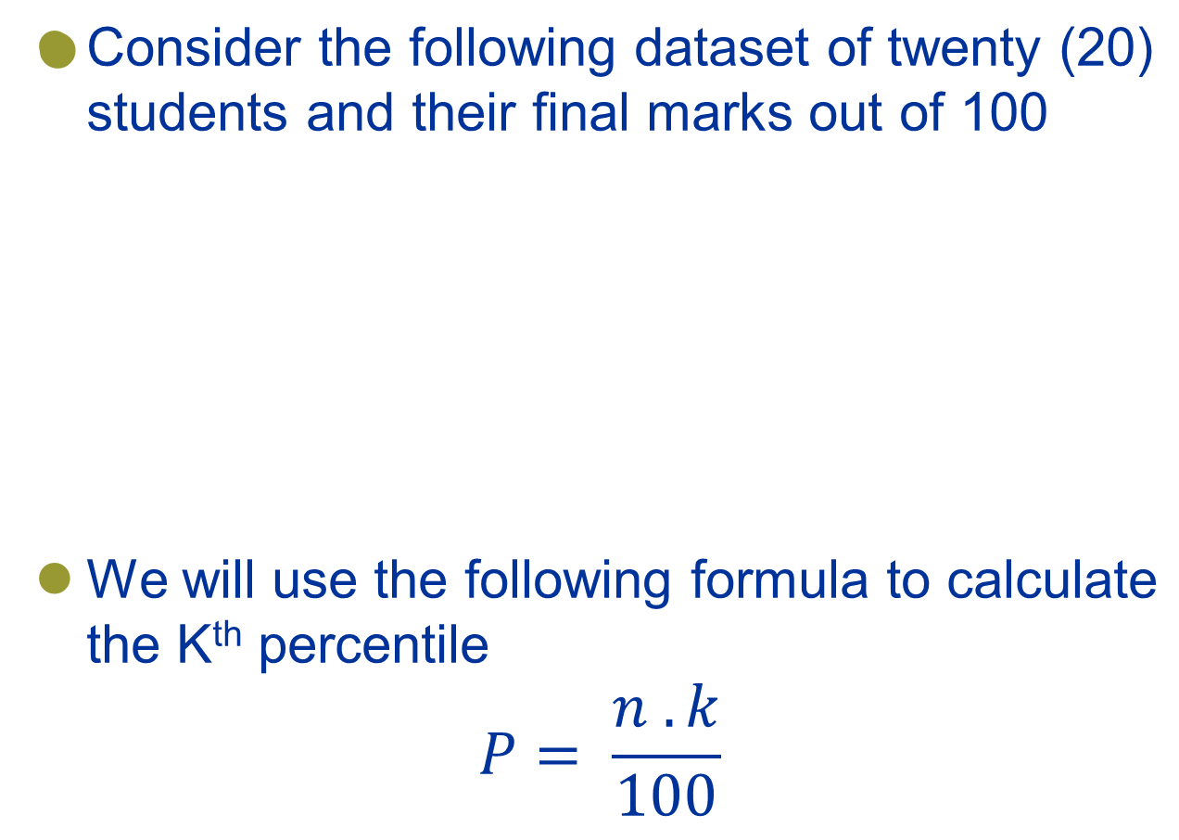
Percentile

Slide 15
Interquartile Range (IQR)
The IQR measures the spread of the middle 50% of the data
iqr = (75th percentile) - (25th percentile)
Consider 25th and 75th percentile value from previous calculation which is 72 & 89 resp…
iqr = 89 – 72 → 17
17 indicates that middle 50% of dataset varies by 17 marks, giving you insight into the data's consistency and spread.

Slide 16
Interquartile Range (IQR)
Question: What indicates a large or small interquartile range (IQR) in a dataset?

Slide 17
Interquartile Range (IQR)
Here are some guidelines
Relative size:
  Context matters: 17 iqr means that the middle 50% of the students' scores vary by 17 marks. Given that the marks range from 60 to 95, this indicates a moderate level of variability.
  Benchmarking: comparing the IQR with similar datasets helps assess its size. An IQR of 10-15 is typical in education, so 17 is relatively large.
Scale of measurement:
  Units matters: 17 out of 100 shows a significant spread in the middle 50% of students, indicating diverse performance levels.
  IQR of 5 may be small in a dataset measuring height (in cm) but large in a dataset measuring daily temperatures (in °C).
  Domain knowledge: Use your knowledge to assess the IQR. For example, an IQR of 10 is typical for test marks, while 30 suggests greater variability.

Slide 18
Interquartile Range (IQR)
Here are some guidelines
Comparison with Standard deviation: If the IQR is much smaller, it indicates a tighter distribution of the middle 50% of values.
  Standard deviation from previous student marks dataset is 11~
  It indicates a significant variability of the student marks in the middle of 50% values
Visualization: Use box plots to visualize data. A wider box plot indicates a larger IQR, suggesting more variability among the middle 50% of data points.

Slide 19
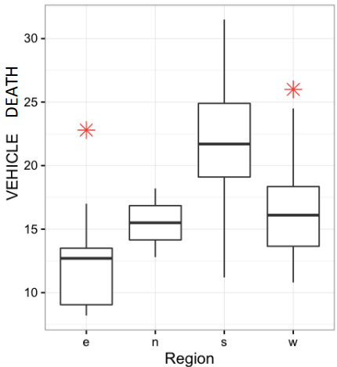
Box Plots
Simpler than histogram
Good for knowing outliers
Easier to use for comparison

Slide 20
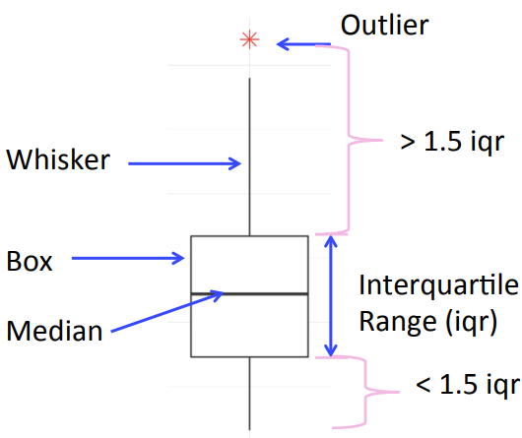
Boxplots Details, Outliers
How to define outliers?

Slide 21
Boxplots Details, Outliers
To draw boxplot, we should know the following
First, second and third quartile which are 25th, 50th and 75th per centiles respectively
Min and max values of range of numbers for identifying outliers [Q1 – 1.5 (iqr), Q2 + 1.5 (iqr)]
The whiskers extend to the smallest and largest non-outlier values in the dataset.

Slide 22
Boxplot of Our Example
First, second and third quartile values are 72, 80 and 89 respectively.
Min and max values of range of numbers are
  [72 – 1.5 x 17, 89 + 1.5 x 17] → [46.5, 114.5]
Whiskers are 60 & 95 values in the dataset.

Slide 23
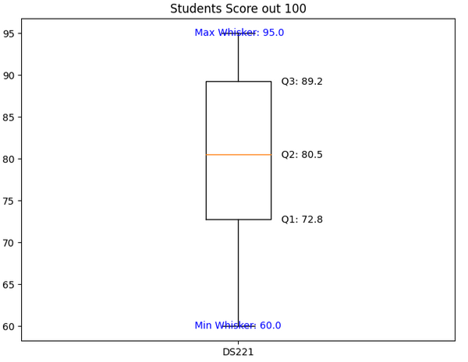
Boxplot of Our Example

Slide 24
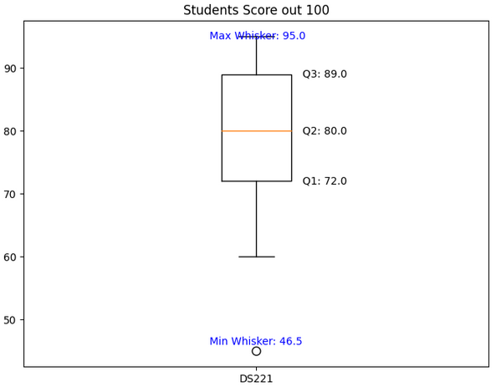
Boxplot of Our Example
Box plot view after adding new student score 45

Slide 25
Your turn
List out your findings after drawing the box plot for the following dataset.
Dataset = {15, 8, 18, 12, 11, 20, 2, 3, 5, 7, 1, 18, 15 }

Slide 26
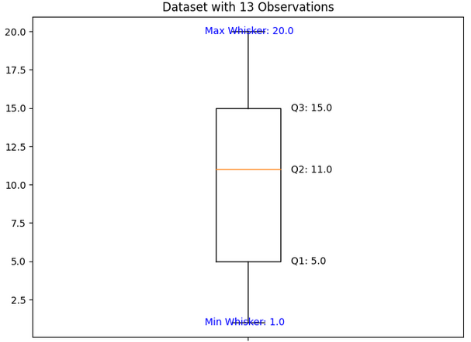
Your turn
Dataset = {15, 8, 18, 12, 11, 20, 2, 3, 5, 7, 1, 18, 15 }
Notes:
15, 8, 18, 12, 11, 20, 2, 3, 5, 7, 1, 18, 15

Slide 27
IQR is Less Sensitive to Outliers
For example:
  dataset = {1, 2, 3, 5, 7, 8, 11, 12, 15, 15, 18, 18, 20}
Original range is 19 - 1 = 18, and the IQR is 10.
If the last value is changed from 20 to 200.
New range is199 - 1 = 198 and the IQR is same
New Range is a significant increase due to the outlier.
The IQR is unchanged because the outlier is outside the middle 50% of the data.

Slide 28
IQR is Less Sensitive to Outliers – Your Turn
dataset = {1, 2, 3, 5, 7, 8, 11, 12, 15, 15, 18, 18, 20}
Change 2 with 200 and observe the difference.
Change 8 with 200 and observe the difference.

Slide 29
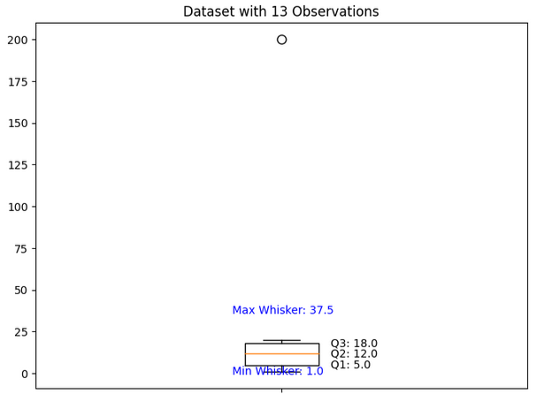
IQR is Less Sensitive to Outliers – Your Turn
dataset = {1, 2, 3, 5, 7, 8, 11, 12, 15, 15, 18, 18, 20}
Change 8 with 200 and observe the difference.

Slide 30
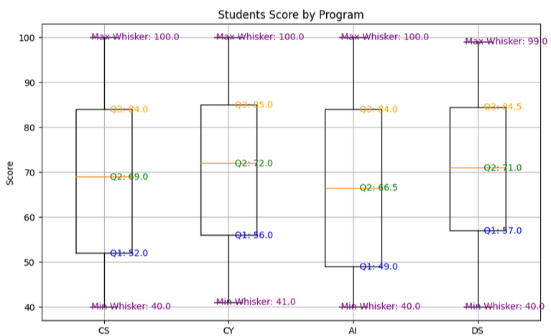
Multiple Boxplots
Comparison of the datasets

Slide 31


Properties of the Interquartile Range
Scaling data scales the interquartile range
Translating the data does NOT change the interquartile range

Slide 32
Sensitivity of summary statistics to outliers
Mean and standard deviation are very sensitive to outliers
Median and interquartile range are not sensitive to outliers

Slide 33
Modes
Modes are peaks in a histogram
If there are more than 1 mode, we should be curious as to why

Slide 34
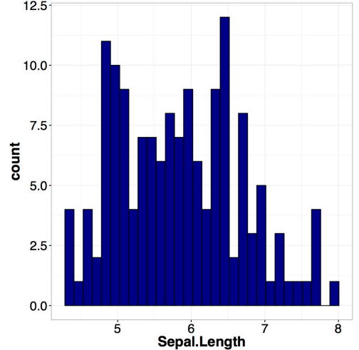
Multiple Modes
We have seen IRIS dataset which looks to have multiple peaks

Slide 35
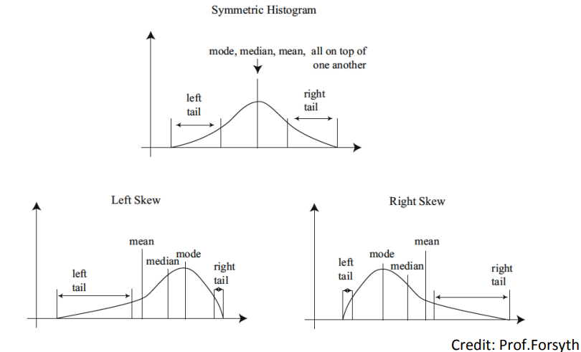
Tails and Skews

Slide 36
Looking at Relationships in Data
Previously, we visualize and summarize 1D values from a dataset containing multiple dimensions.
Finding relationships between features (dimensions) in the dataset or many datasets is one of the most important tasks in data science.

Slide 37
Visualizing Relationships with Heatmap
A heatmap is a graphical representation of data where individual values are represented by colors.
Display matrix of data via gradient of color
Highlighting relationships between two dimensions in a dataset.

Slide 38
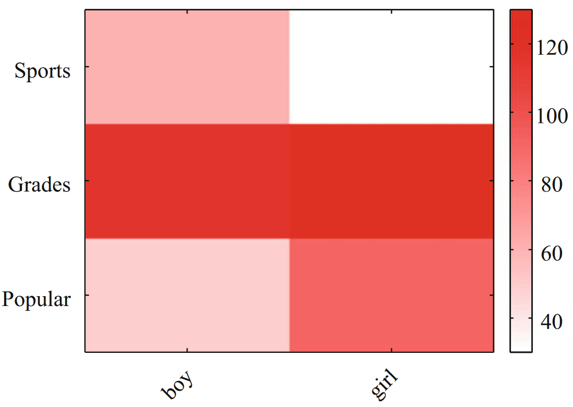
Visualizing Relationships with Heatmap
A heat map of the Chase and Dunner data.
https://lib.stat.cmu.edu/DASL/Datafiles/PopularKids.html

Slide 39
Visualizing Relationships with Heatmap
The color of each cell corresponds to the count of the number of elements of that type
The color bar at the side gives the correspondence between color and count
By just looking at the visualization, you can get the idea that
  The number of boys and girls preferring grades is similar
  Boys favor sports slightly over popularity, while more girls prefer popularity over sports.

Slide 40
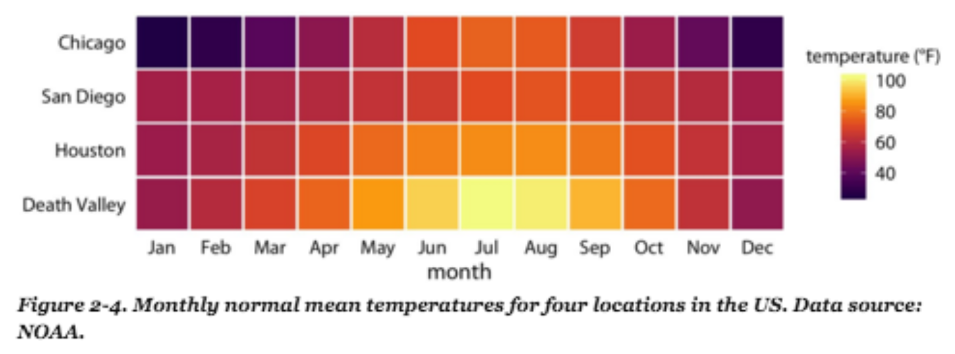
Visualizing Relationships with Heatmap
Summarization of 4 locations annual mean temperature by month

Slide 41
Visualizing Relationships with 3D Bar Chart
A 3D bar chart represents data with bars in three dimensions
Highlighting relationships between two dimensions in a dataset.

Slide 42
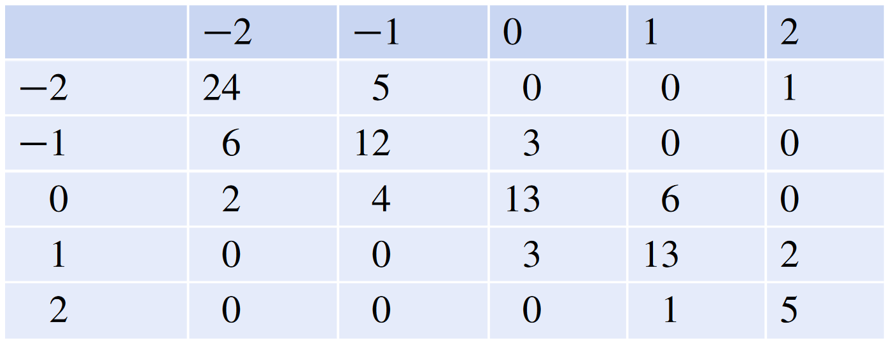
Visualizing Relationships with 3D Bar Chart
Consider the following simulated data representing user evaluations of a user interface
Enjoyability
Ease of use
Scale: -2 very bad – to 2 very good

Slide 43
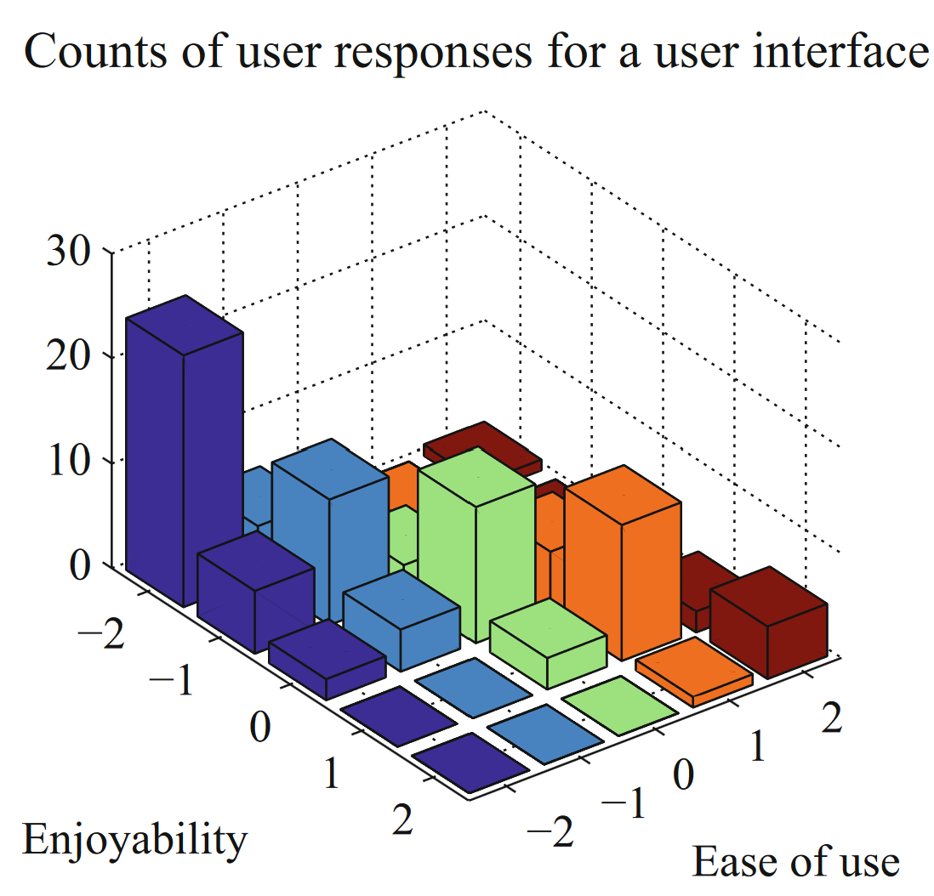
Visualizing Relationships with 3D Bar Chart

Slide 44
Visualizing Relationships with 3D Bar Chart
The height of each bar is given by the number of users in each cell.
This 3D plot immediately reveals that users who found the interface hard to use did not like using it either.
However, some of the bars at the back are hidden, so some structure might be hard to infer.

Slide 45
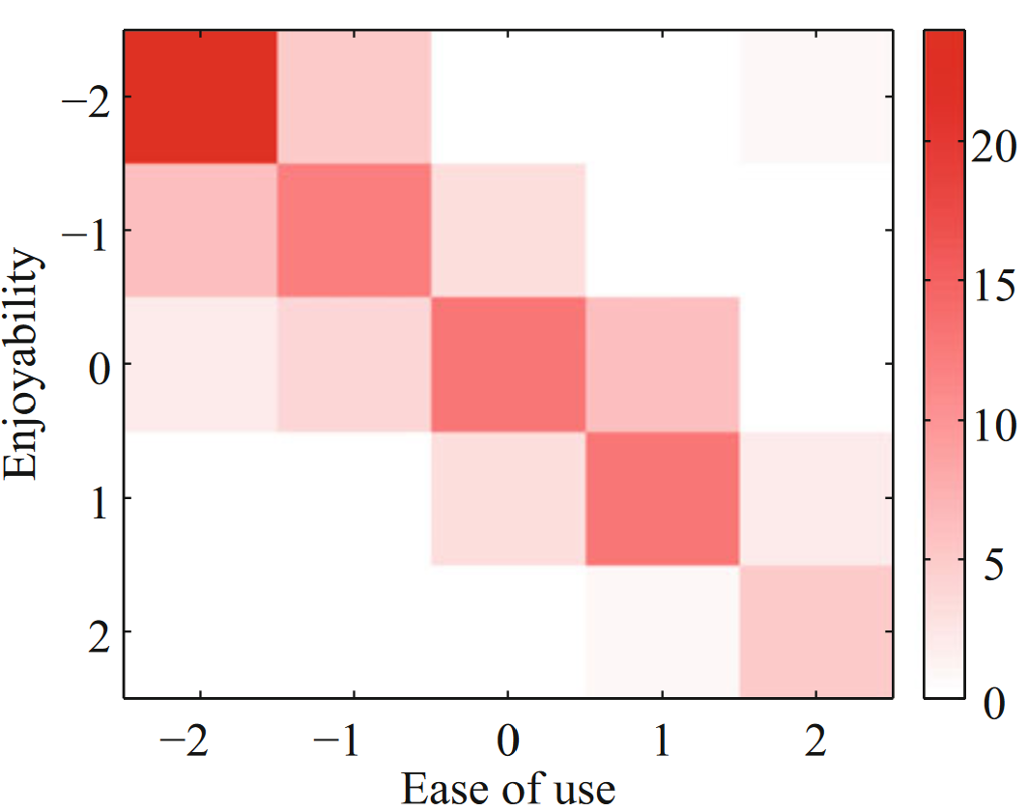
Visualizing Relationships with Heatmap

Slide 46
Visualizing Relationships with Heatmap
Again, this plot immediately reveals that users who found the interface hard to use did not like using it either.
It’s more apparent that everyone disliked the interface, though, and it’s clear that there is no important hidden structure

Slide 47
Relationship between data features
It isn’t always natural to plot data as a function.
For example, in temperature and blood pressure of a set of patients, there is no reason to believe that temperature is a function of blood pressure, or the other way round.
It means that two people could have the same temperature, and different blood pressures, or vice-versa

Slide 48
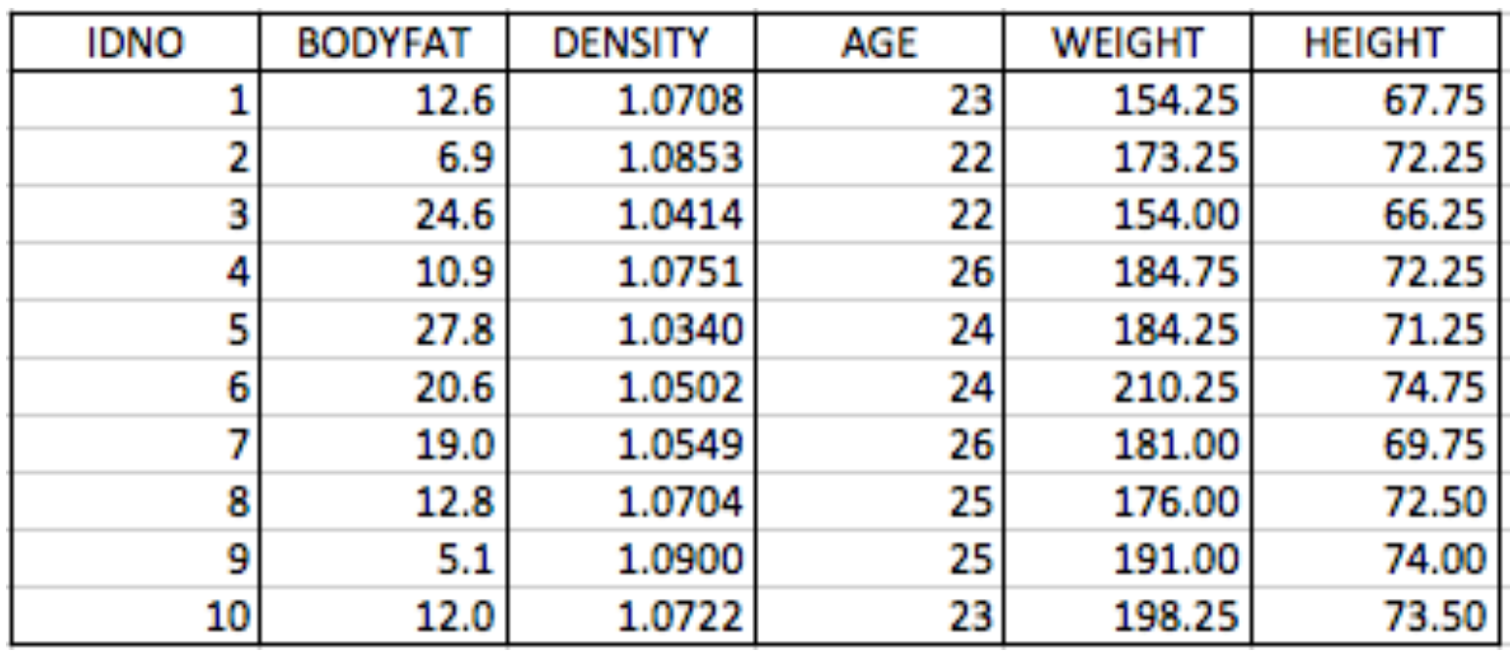
Relationship between data features
Example: does the weight of people relate to their height?

Slide 49
Relationship between data features
Height vs. Weight: When analyzing the relationship between the height and weight of individuals, each height can correspond to multiple weights and vice versa.
Income vs. Education Level: relationship between income and education level, individuals with the same education may have different incomes.

Slide 50
Relationship between data features
While 3D bar charts and heatmaps are effective for visualizing relationships among categorical variables, they assume a direct functional relationship.
However, in cases like height vs. weight, both variables are continuous, making it difficult to create meaningful bins or categories. The resolution can be lost, and important patterns may be obscured.
The scatter plot is a powerful way to deal with this situation.

Slide 51
Scatter Plot
Each point in the scatter plot represents an individual observation, with its position determined by the values of two variables, revealing their relationship.
A trend line can be added to the scatter plot to indicate the overall direction or correlation between the variables, helping to visualize patterns and relationships.
Remember this: Scatter plots are a most effective tool for geographic data and 2D data in general. A scatter plot should be your first step with a new 2D dataset.

Slide 52
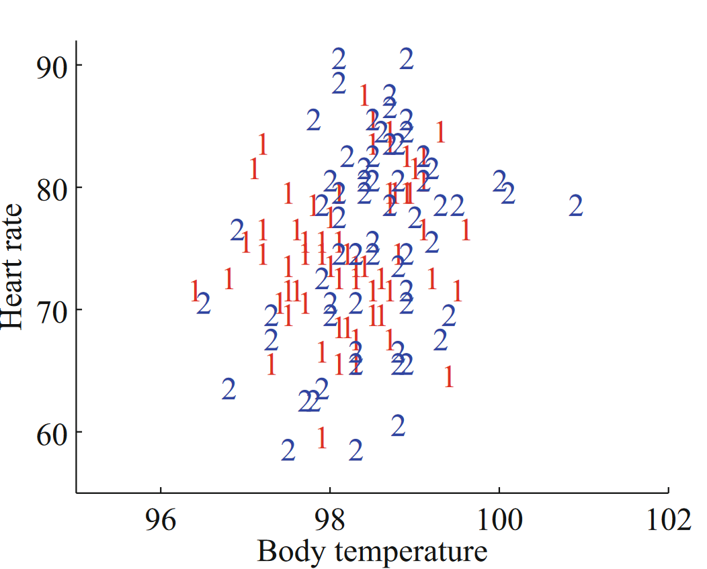
Scatter Plot
scatter plot of body temperature against heart rate
Dataset: http://www2.stetson.edu/~jrasp/data.htm

Slide 53
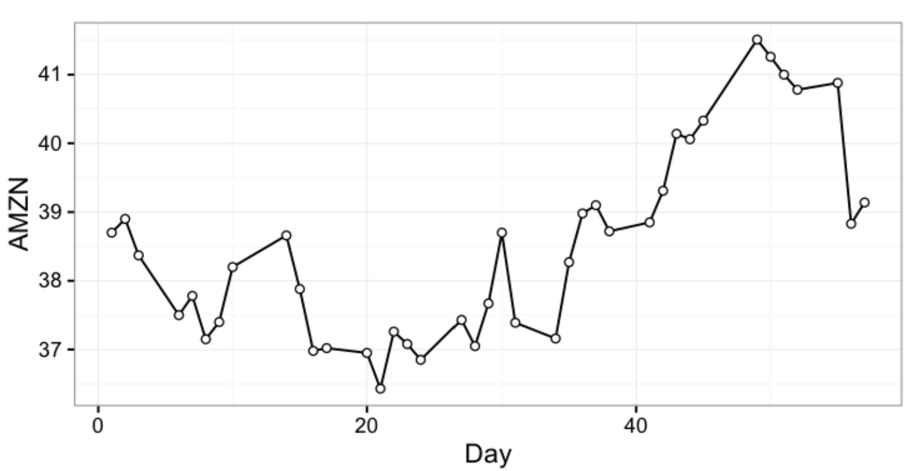
Scatter Plot
Time series plot: Stock of Amazon

Slide 54
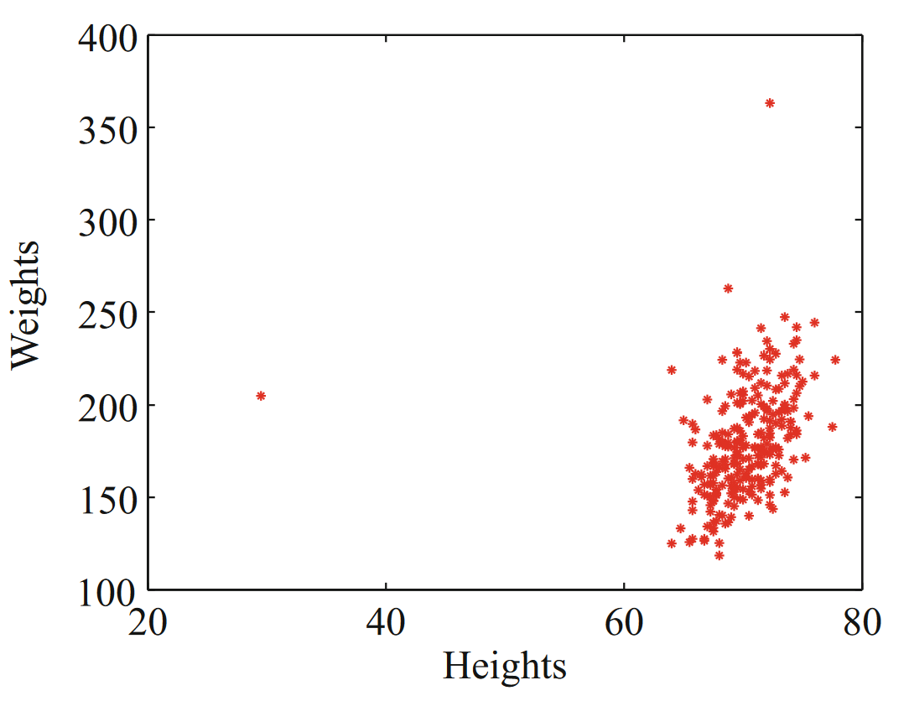
Scatter Plot
Scatter plot of weight against height
Dataset: http://www2.stetson.edu/~jrasp/data.htm

Slide 55
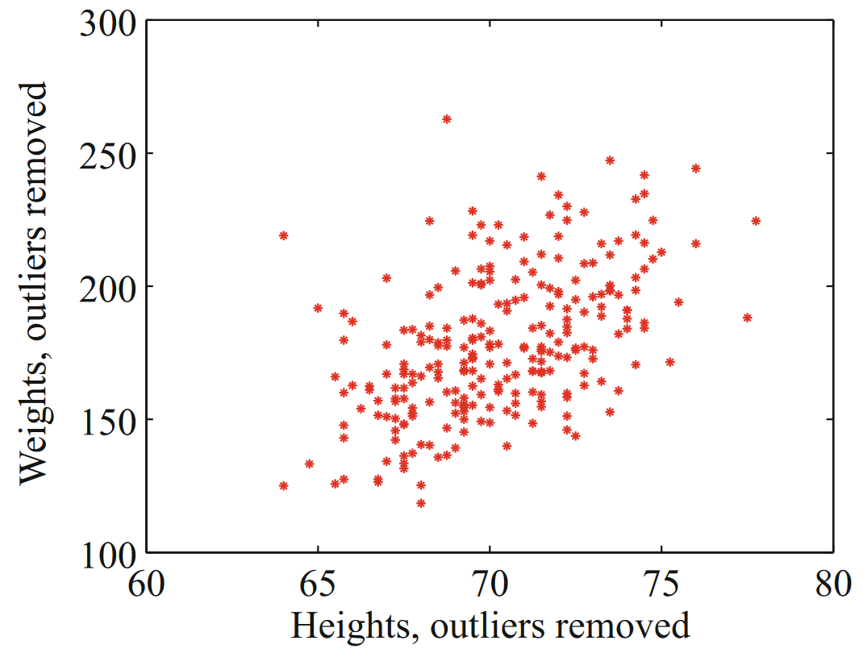
Scatter Plot
Scatter plot of weight against height
Dataset: http://www2.stetson.edu/~jrasp/data.htm

Slide 56
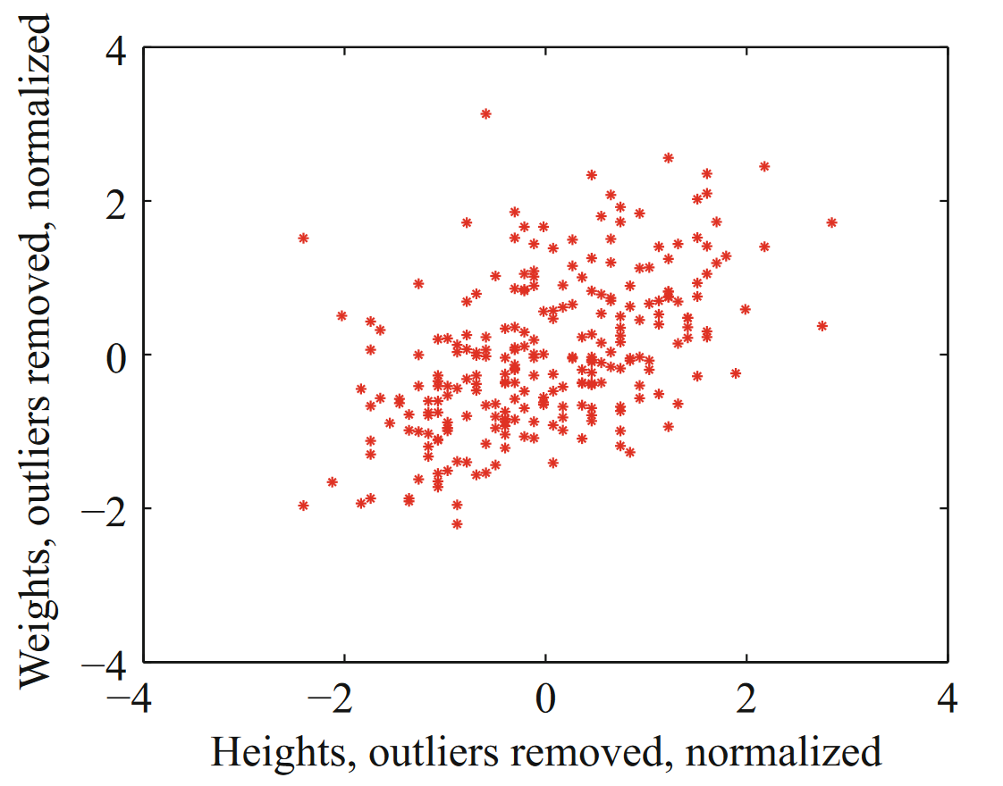
Scatter Plot
Scatter plot of weight against height
Dataset: http://www2.stetson.edu/~jrasp/data.htm

Slide 57
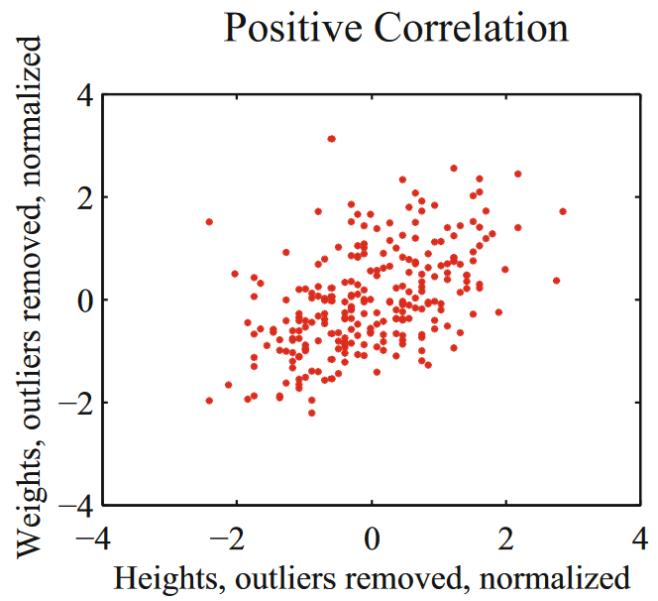
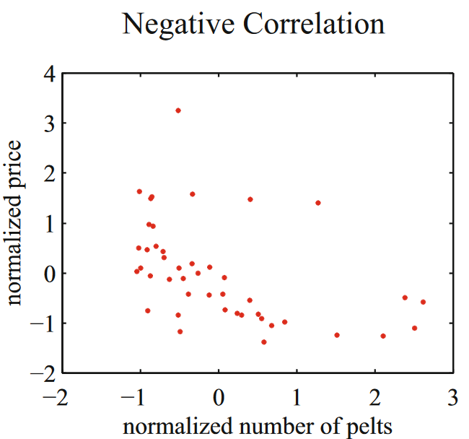
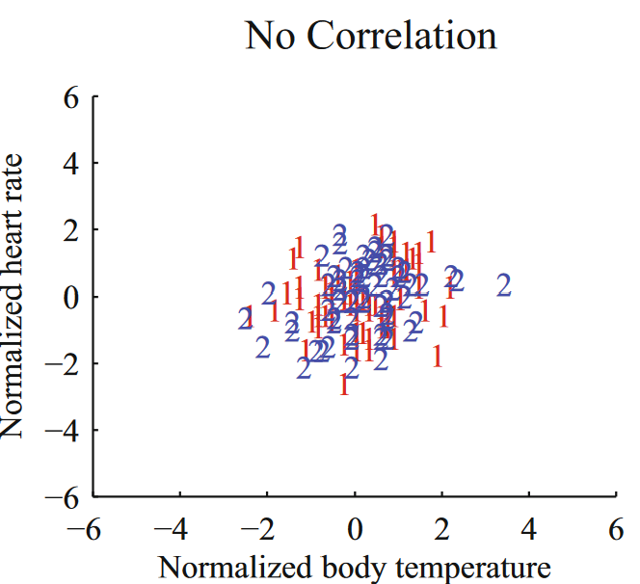
Correlation Seen from Scatter Plots

Slide 58
Correlation Seen from Scatter Plots
Positive Correlation – when one variable increases, the other variable also tends to increase.
  Weight-height plot: individuals who are higher tend to weigh more. The important word here is “tend”—taller people could be lighter, but mostly they tend not to be.
Negative Correlation – when one variable increases, the other variable tends to decrease.
  Pelts-price plot: suggests that when there were more pelts, prices were lower, as one would expect.
Zero Correlation – No relationship b/w variables.
  Pelts-price plot: suggests that when there were more pelts, prices were lower, as one would expect.

Slide 59
What Kind of Correlation?
Line of code in a database and number of bugs
GPA and number of hours spent playing video games
Earnings and happiness

Slide 60
Correlation does not Mean Causation
Ice cream sales and temperature are correlated – however, this doesn’t mean that buying ice cream causes the temperature to rise.
Height and weight are correlated, but this doesn’t mean that increasing height will lead to greater weight for everyone.

Slide 61
Correlation
Question: How can we tell if two variables are positively, negatively, or not correlated?

Slide 62
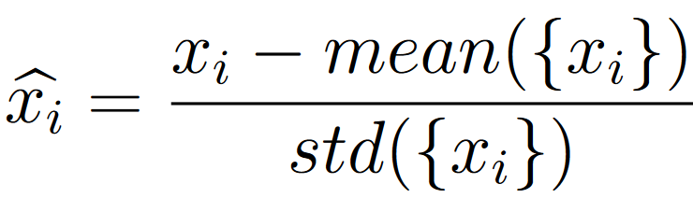
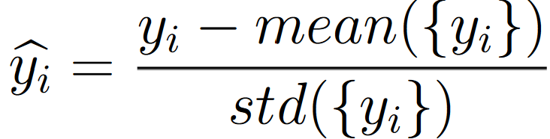
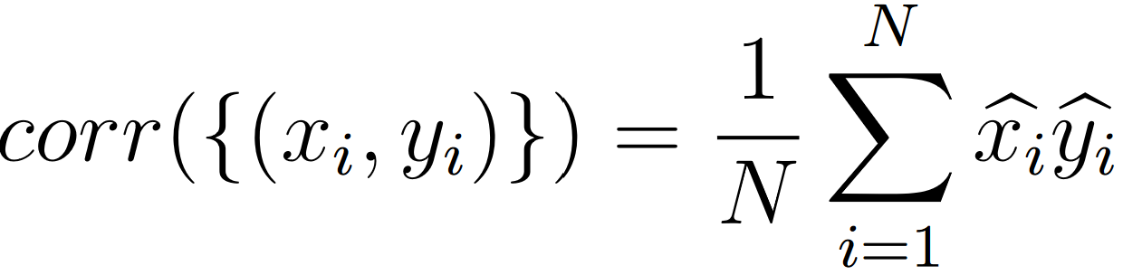
Correlation Coefficient
Given a dataset {x_{i}, y_{i}} consisting of items (x₁, y₁) … (x_{N}, y_{N})
Standardize the coordinates of each feature:
Now we can define the correlation coefficient as:

Slide 63
Correlation Coefficient
Question: Which of the following describe(s) correlation coefficient correctly?
It’s unitless
It’s defined in standard coordinates
Both A & B
All of the above

Slide 64
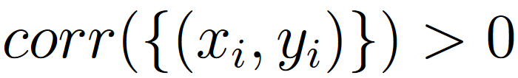


Correlation Coefficient
In a dataset {x_{i}, y_{i}} consisting of items (x₁, y₁) … (x_{N}, y_{N})
Shows +ve correlation
Shows -ve correlation
Shows no correlation

Slide 65
Correlation Coefficient – Demo
A visualization of correlation coefficient
https://rpsychologist.com/correlation/

Slide 66
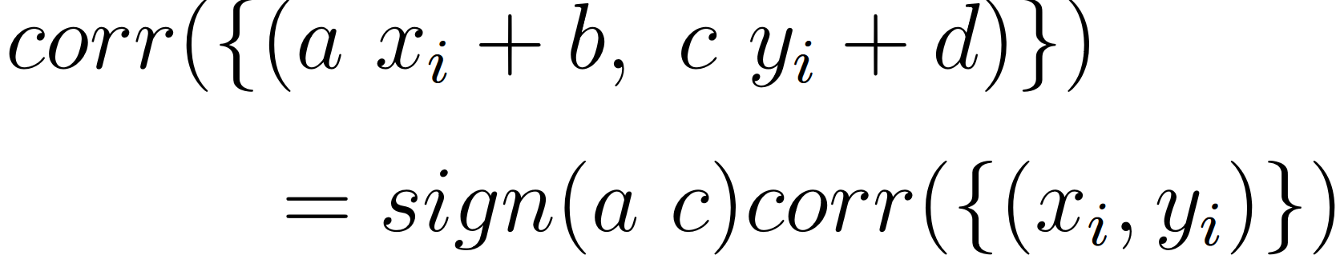
Properties of Correlation Coefficient
The correlation coefficient is symmetric
Translating the data does NOT change the correlation coefficient
Scaling the data may change the sign of the correlation coefficient

Slide 67
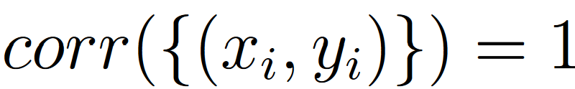
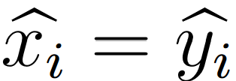
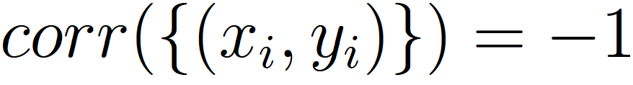
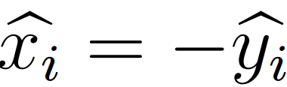
Properties of Correlation Coefficient
The correlation coefficient is bounded within [-1, 1]
If and only if
If and only if

Slide 68
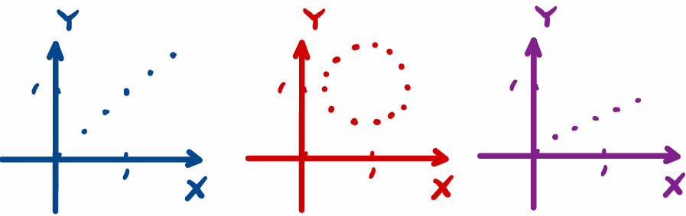
Correlation Coefficient
Question: Which of the following has a correlation coefficient equal to 1?
Left and right
Left
Middle

Slide 69
Using Correlation Coefficient to Predict
Given a correlated data set { (x_{i}, y_{i}) }
We can predict (y₀)^{p} for a given x₀ using correlation coefficient (r)
In standard coordinates { (x̂_{i}, ŷ_{i}) }
We can predict ŷ₀^{p} for a given x̂₀ using correlation coefficient (r)

Slide 70
Using Correlation Coefficient to Predict
Our target is to construct a prediction function which gives a prediction of any value of x̂
The simplest form of predictor is linear predictor
  ŷ_{i}^{p} = ax̂_{i} + b where a & b are unknown
The error in the prediction is denoted by u_{i}
  u_{i} = ŷ_{i} - ŷ_{i}^{p} i.e. will indicate the error in the prediction
  We would like to have mean({ u }) = 0

Slide 71
Require mean({ u }) = 0
So that it is also centered around 0 as the standardized datâ
mean({ u }) = mean({ ŷ - ŷ^{p} })
= mean({ ŷ }) - mean({ ax̂_{i} + b })
= mean({ ŷ }) – a mean({ x̂ }) + b
= 0 – a (0) + b
= 0
This means that we must have b = 0

Slide 72
Require the Variance of Error is Minimal
To estimate a, we need to think about var ({u})
We would like var({u}) as small as possible
Remember: small variance means small standard deviation which means the data is close to the mean

Slide 73
Require the Variance of Error is Minimal
var({ u }) = var({ ŷ - ŷ^{p} })
= mean({ (ŷ - ax̂)² }) because mean({u}) = 0
= mean({ (ŷ)² -2(a)(x̂ŷ) + a²(x̂)² })
= mean({(ŷ)²}) – 2amean({x̂ŷ}) + a²mean({(x̂)²})
= 1 – 2ar + a²
We want to minimize by choice of a. At the minimum, we must have
dvar({u_{i}}) / da = 0 = – 2r + 2a
So that a = r and the correct prediction is
ŷ_{i}^{p} = rx̂_{i}

Slide 74
Procedure – Predicting a Value Using Correlation
Transform the data set into standard coordinates, to get
Compute the correlation
Predict ŷ_{i}^{p} = rx̂_{i}
Transform this prediction into the original coordinate system, to get
  ŷ_{i}^{p} = std(y) . r . x̂_{I} + mean({y})

Slide 75
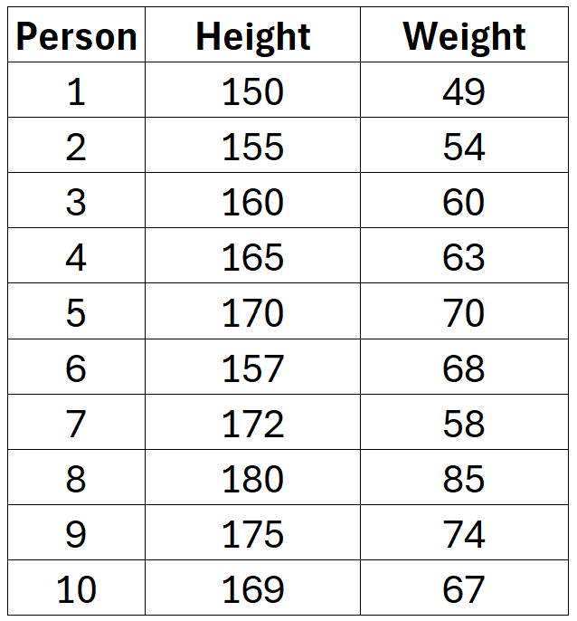
Predicting a Value Using Correlation – Example
Consider the following height & weight sample dataset of 10 persons.
Group Activity:
Draw the scatter plot
Predict the weight based on height using correlation coefficient and linear predictor
Draw the linear predictor line on your scatter plot

Slide 76
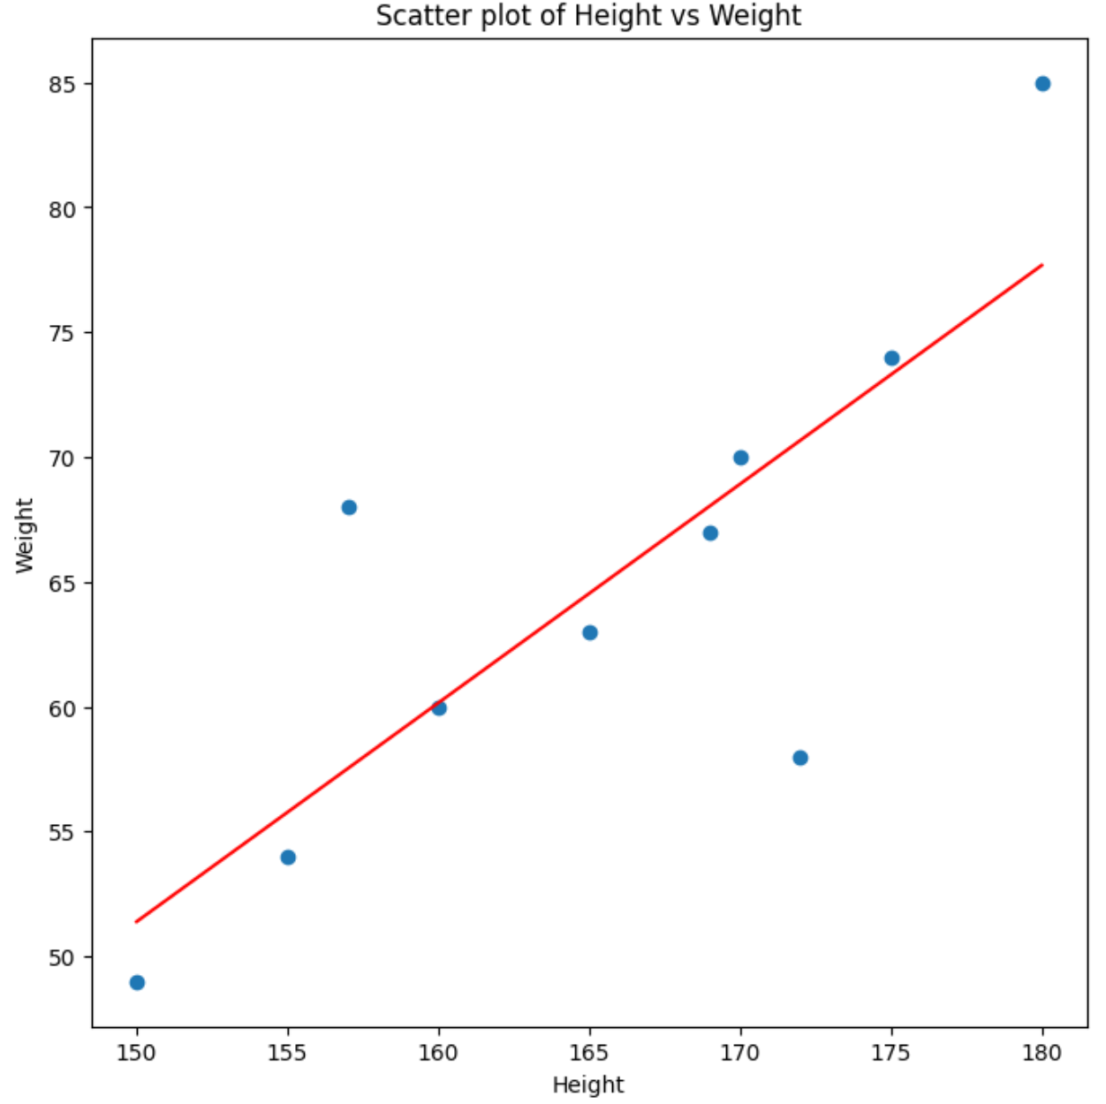
Predicting a Value Using Correlation – Example (see demo files)
Correlation Coefficient (r) = 0.8081

Slide 77
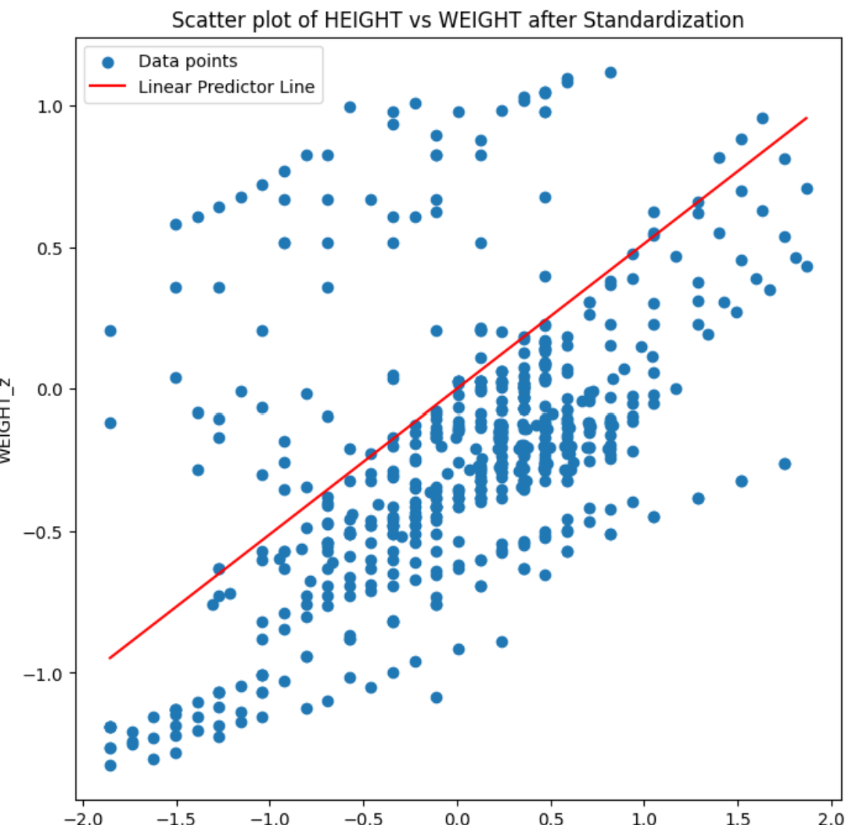
Linear Predictor Line of Scatter Plot – see demo files on teams

